Slide 1









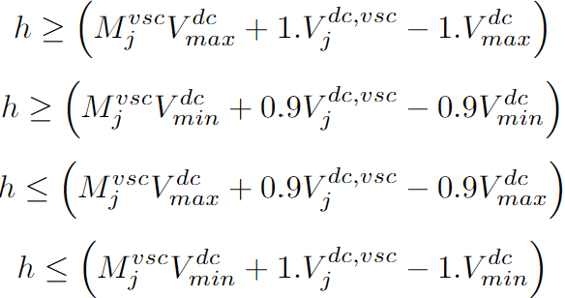




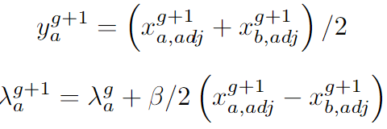
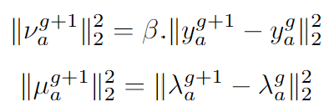




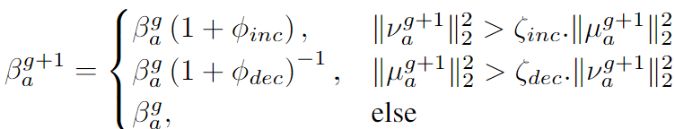
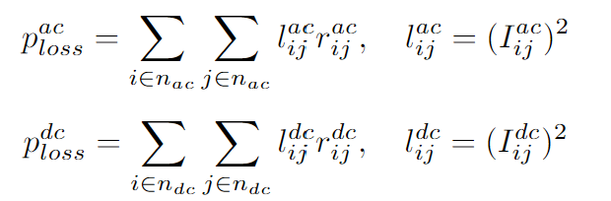
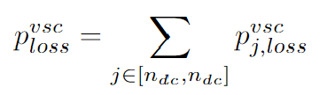
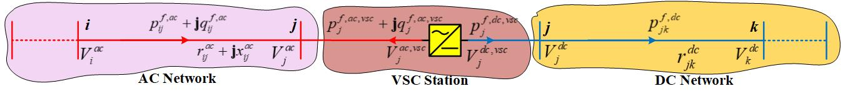
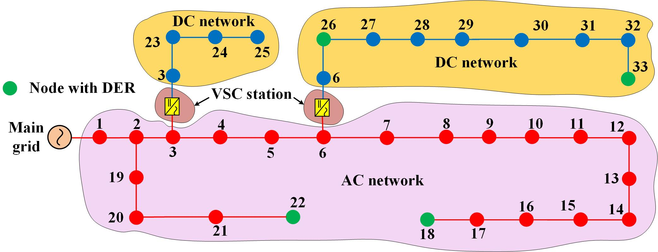
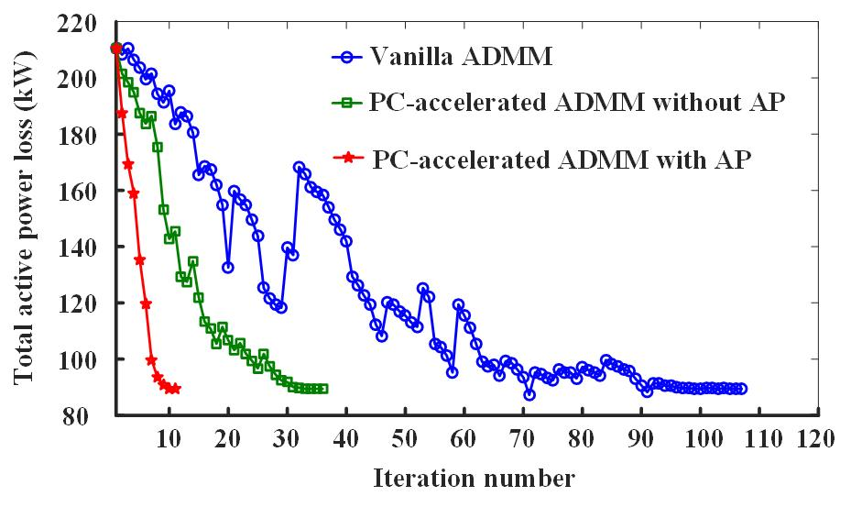
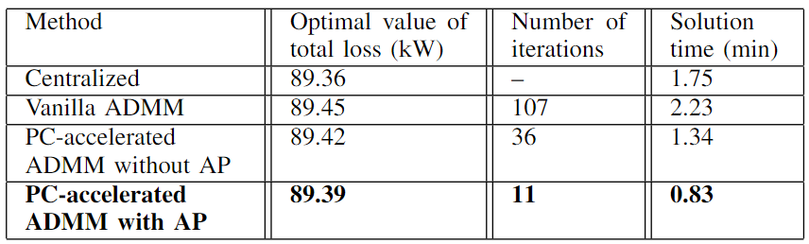
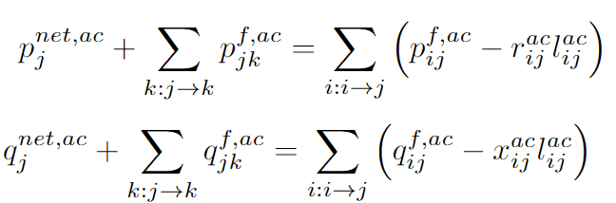
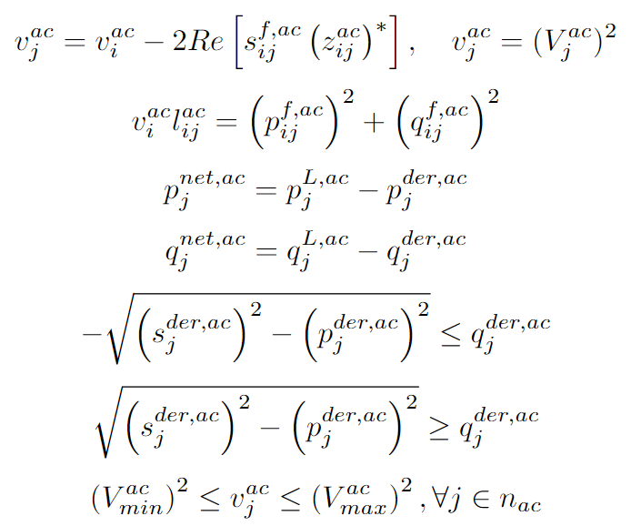
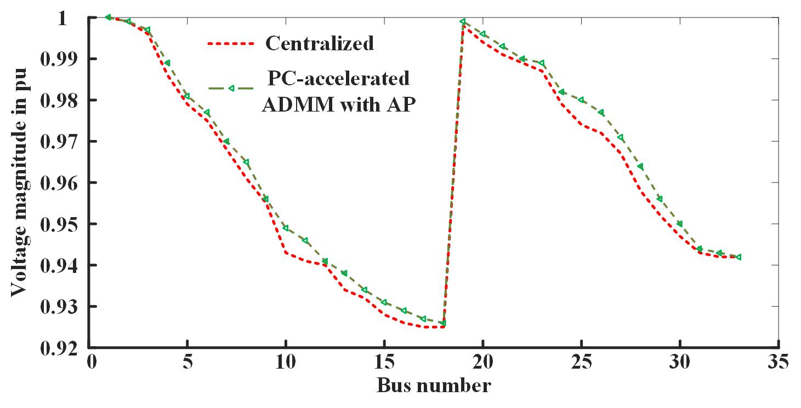
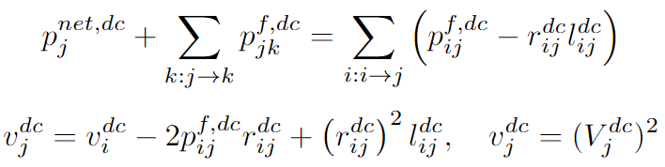
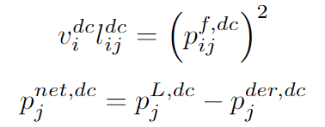

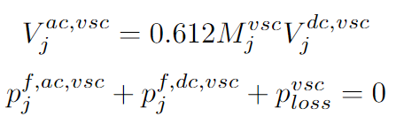
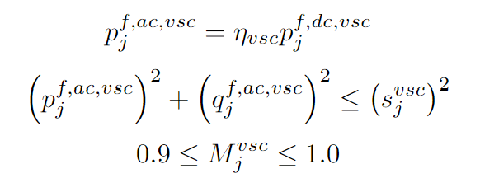
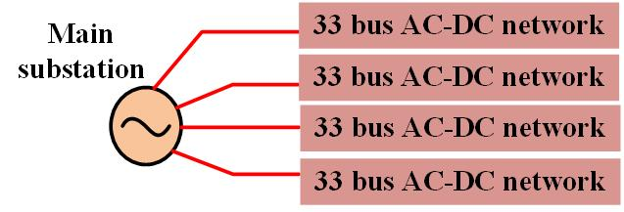
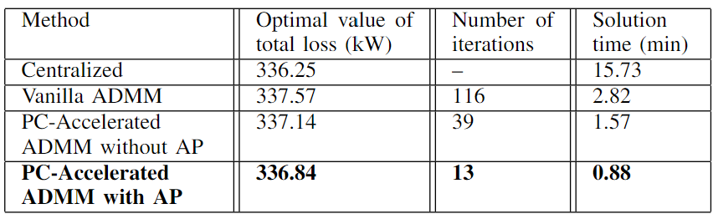

IEEE PES General Meeting, 21–25 July 2024, Seattle, Washington, USA
Predictor-Corrector Accelerated ADMM Method for the SOCP-Relaxed AC-DC Optimal Power Flow
Subho Paul¹, Krishna Murari², Narayana Prasad Padhy³, and Sukumar Kamalasadan⁴
¹Department of Electrical Engineering, Indian Institute of Technology (BHU), Varanasi, 221005, UP, India
²Electrical Engineering and Computer Science Department, The University of Toledo, Toledo, OH, USA.
³Department of Electrical Engineering, Indian Institute of Technology Roorkee, Roorkee-247667, UK, India
⁴Energy Production and Infrastructure Center, University of North Carolina, Charlotte, NC, USA.
Email: subho.eee@iitbhu.ac.in, krishna.murari@utoledo.edu, nppadhy@ee.iitr.ac.in, skamalas@charlotte.edu
Key points
Proposed Accelerated Distributed SOCP Relaxed AC-DC OPF
Start
AC-DC networks are often proposed as a possible solution to avoid large use of AC-DC converters for integrating DC renewable energy resources and DC loads into AC distribution networks with minimum conversion loss.
Optimal Power Flow (OPF) stands out as a valuable tool for facilitating the practical realization of AC-DC networks through their optimal operation management. Therefore, the design of an efficient OPF algorithm is becoming more pertinent for such networks [1].
Conventional centralized OPF suffers from scalability issues and Vanilla Alternating Direction Method of Multipliers (ADMM) performs large number of macro-iterations (≈ 10²) to converge. Hence both possess slow solution process.
Predictor-corrector type acceleration mechanism [2], is merged with the basic vanilla ADMM to solve the SOCP relaxed AC-DC OPF problem.
The acceleration mechanism involves updating the values of both boundary and dual variables when both primal and dual residuals are decreasing. This simultaneous adjustment speeds up the solution process, leading to an efficient convergence..
The concept of adaptive penalty (AP) is incorporated with the accelerated ADMM, which allows for updating the penalty parameter at every iteration for fast but reliable convergence.
SOCP Relaxation: Non-convex quadratic equality constraints are relaxed as inequalities by adopting cone relaxation
Linearization: Non-convexity due to bilinear term in VSC station model is linearized using McCormick envelopes
Vanilla ADMM Method: the centralized AC-DC OPF problem is decomposed into three local sub-problems corresponding to the areas (indexed by ‘a’) like AC networks, DC networks, and VSC stations, which are solved in parallel by sharing the values of the boundary variables (voltage and power flow) with the neighboring agents. Each area solves following optimization problem.
At each iteration following operations are performed to determine local (x), global (y), dual variables, primal and dual residuals
Predictor-Corrector (PC) Acceleration: Global and dual variables are updated in intermediate steps if the values of the primal and dual residuals at the current iteration are decreased from that of their previous iteration.
Adaptive Penalty (AP): Different penalty parameter (β) values are assigned for each local sub-problem and those are updated at every iteration as large β values result in the oscillating solution and smaller values lengthen the convergence process.
Initialization of the parameters and set tolerance limits
Follow the steps of vanilla ADMM to determine local, global and dual variables
Calculate the values of primal and dual residuals with current penalty parameter
No
If residuals are decreasing
Yes
Use previous values of local, global, and dual variables
Update the local, global, and dual variables by following PC acceleration
Centralized AC-DC OPF Problem Formulation
Update the values of penalty at each area using AP
The OPF framework aims to minimize the total active power loss in the network
The above objective function is minimized to determine the optimal reactive power dispatch from solar inverters and voltage source converters (VSCs), and modulation index of VSCs, considering the operating constraints of the AC network, DC network and VSC stations.
AC Network Modelling:
DC Network Modelling:
VSC Station Modelling:
If residuals are lesser than tolerance
No
Yes
Consensus and optimal decision
Case Study Demonstration
The developed method is tested on the 33-bus AC-DC network consisting of four solar DERs, one big AC network, two VSC stations, and two DC networks, shown in Fig. 2.
The DERs are of 500 kW capacity each and the inverters at AC network are of 600 KVA rating.
The simulation is carried out for base load conditions and 1 pu power generation from the DERs.
The convergence curve of PC-accelerated ADMM with AP experience no fluctuation and fast convergence (0.83 min).
Now, for scalability checking, the proposed method is further tested on a 132-bus AC-DC network (Fig. 5),
taken having 8 DC networks, 4 AC networks, and 8 VSCs.
It is noted that for the centralized method, the solution time increases with the network size, but due to parallel computation,
the ADMM-based distributed algorithms take almost a similar time as the 33-bus network.
Fig. 1. Structure of AC-DC distribution network
Table 1. Performance evaluation with 33-bus test system
Fig. 2. 33-bus AC-DC radial test system
Fig. 3. Convergence curve of different methods for 33-bus test system
Fig. 4. Bus voltage for centralized and proposed approaches for 33-bus system
Table 2. Performance evaluation with 132-bus test system
Conclusions
This article proposes an accelerated ADMM framework for solving the AC-DC OPF problem in a distributed manner.
The centralized problem is decomposed into three distinct problems for AC networks, DC networks, and VSCs, and solved in parallel till consensus is attained.
Performing detailed case study demonstrations on 33 and 132-bus test systems, it is proved that the proposed PC-accelerated ADMM with AP method outperforms the conventional centralized and vanilla ADMM methods, and its performance is not impacted by the increasing size of the AC-DC network.
Fig. 5. 132 bus AC-DC radial test system for scalability analysis
References
[1] S. Paul and N. P. Padhy, “A new iterative mixed integer linear programming based real time energy efficient management of AC-DC distribution networks,” Int. J. Elect. Power Energy Syst., vol. 157, art. no. 109793, 2024.
[2] T. Goldstein, et al., “Fast alternating direction optimization methods,” SIAM Journal of Imaging Sciences, vol. 7, no. 3, pp. 1588–1623, 2014.

